Slide 1
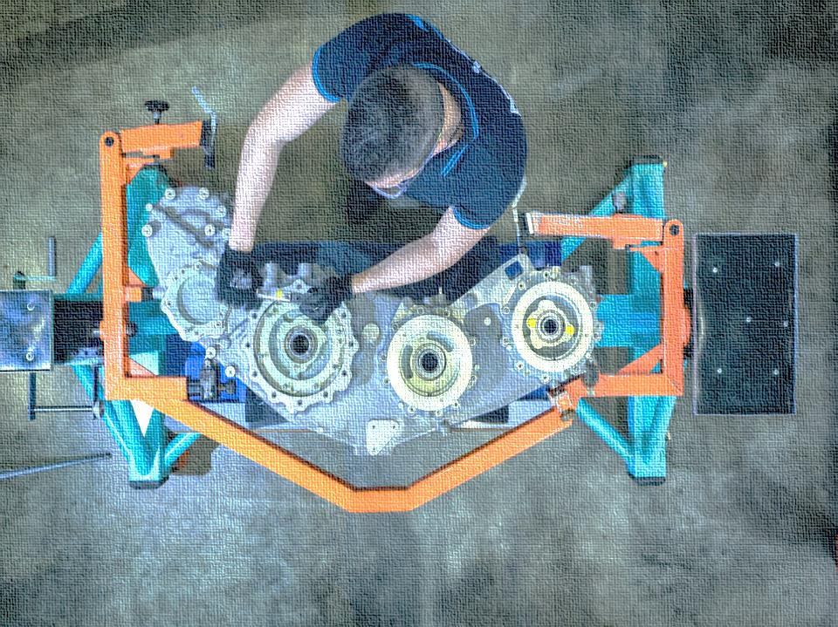

GE Predix Hackathon Team Whizcubs
Ajaya Kumar Swain
Rakesh Kumar Nayak
Subrajit Das
Subhasish Bhaumik
Anirban Mukherjee

Slide 2



Problem Statement
Avio Aero, a GE Aviation business, is an Italian company operating in the aerospace sector. They provide their clients with technological solutions for mechanical transmissions, turbines, combustion chambers.
Have a continuous integration of Real time flight data with Analytical platform.
To store and analyze the data to produce accurate Geospatial coordinates.
Plotting of Analytical output on a Dashboard and making it accessible to various Users and applications.

Slide 3
Our Solution
Goals | Data stored on the DB have to be plotted on the Predix UI Flight path will have to be calculated by running a Matlab web service. SSO authentication to the web portal is required .
Solutions | Avio sends real time data with time as independent dimension & dependent variables such as : velocity for 3 dimensions, altitude, direction, wind variability Push data to Predix data base using Microservice to Postgres Database instance using Postgres Service. Creating Microservice on Postgres DB for Data input to Analytics and Dashboard. To transform the User algorithms to Predix readable and consumable format. To add the Analytics algorithms to the catalog. Analysis finds a distance & geospatial coordinates at a given point of time using inverse trigonometric calculation. Analysis also finds a correlation coefficient to understand & justify the variability of the variables with the time quantity To create analytical Dashboard with UAA authentication.
Challenges | SSO authentication with Dashboard. We faced design level issue and opened a tickets with GE digital team

Slide 4
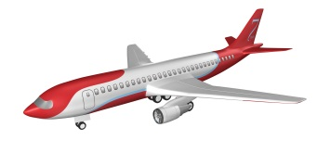








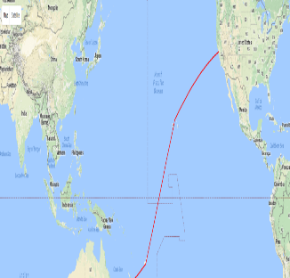
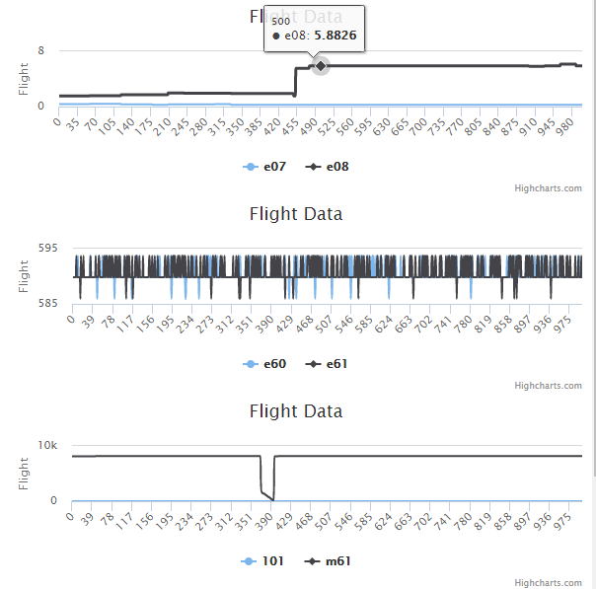
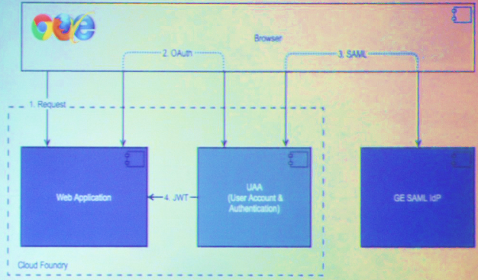
Connectivity
Technology Integration
Cloud Services
UI Application
Business shared the CSV files –
Scope Start
UAA
Data
Analytics
Security
Created Micro service (read SQL script and load to Postgre SQL
Data Ingestion
Microservice
The Build pack presented in predix viz., Used R2015 A
and created JAR for compilation
Connect Machine
Collect key flight data and flight path and stream it into the Predix Cloud viz., PostgreSQL
Implement Services
Leverage the Build packs and development tools of Predix and solved the problem Analytics component
Deliver
Used the Predix cloud to deploy the created micro services and in secure environments | Integrated YouTube, Facebook & Twitter Live feed data on landing page

Slide 5
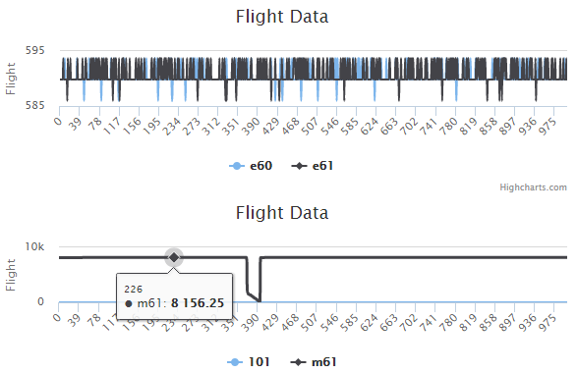
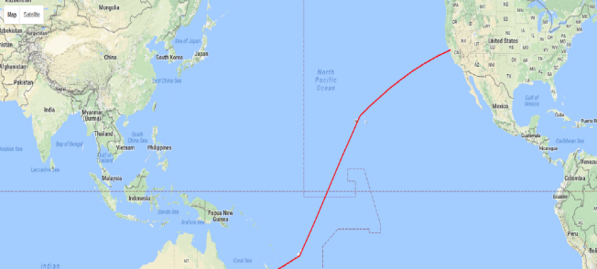
Application Screenshot
Variables
Time Frame
Coordinate data on satellite map image

